Slide 1
Demand- Importance
Determination of a firm’s profitability
Planning production activity
Financial decision
Human resource planning
Influence production technologies

Slide 2
Individual Demand
Willing to purchase
Purchasing power (ability to pay)
Over specific time period
Demand depends on price of commodity
Demand also depends on Income, taste, price of related commodity

Slide 3
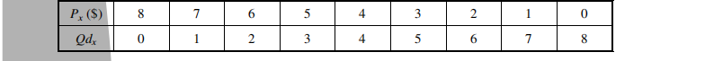
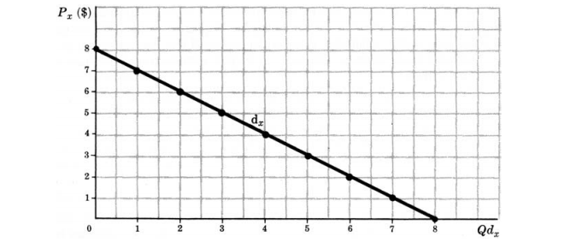

Slide 4
Market Demand
The market or aggregate demand for a commodity gives the alternative amounts of the commodity demanded per time period, at various alternative prices, by all the individuals in the market.

Slide 5
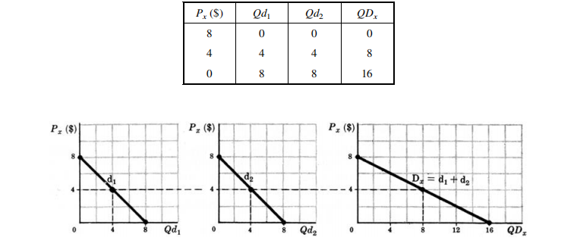

Slide 6
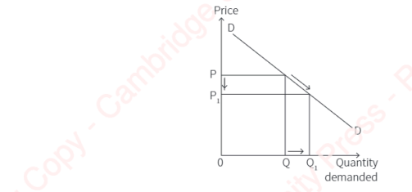
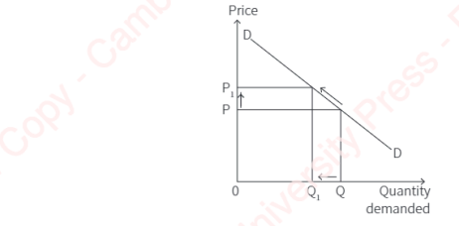
Extension Contraction

Slide 7
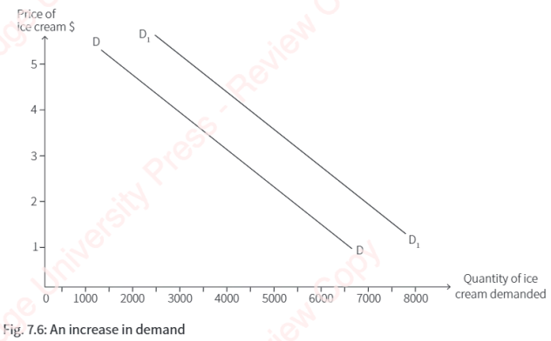
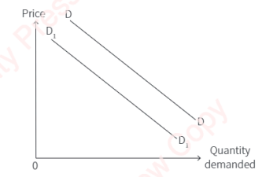
Shifts in Demand

Slide 8
Why does demand fall downwards
Income effect
Substitution effect
Diminishing Marginal utility

Slide 9
Exception of Law of Demand
Veblen effect
Giffen effect

Slide 10
Factors determining Demand
Tastes and preference of consumers
Income of the people
Changes in price of related goods
Advertisements
Number of consumers in the market
Consumers expectation with regard to future demand

Slide 11
Derived demand
Bandwagon effect
Snob effect

Slide 12
Elasticity of Demand
Price elasticity
Cross elasticity
Substitution elasticity
Income elasticity

Slide 13
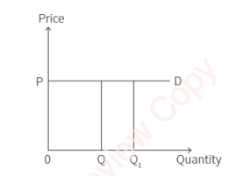
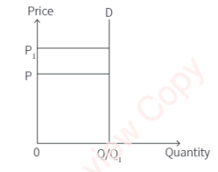
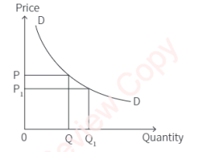
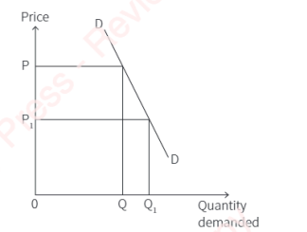
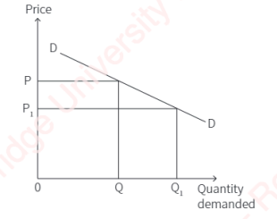
Types of Price elasticity

Slide 14
Measuring price Elasticity of Demand
Total Outlay method
Arc method
Point method

Slide 15
Importance of Elasticity of Demand
For decision making both by business firms and industries
Plays a significant role in designing marketing strategies of the firms
Pricing decisions
Taxation policies
Business strategy
To understand consumer behavior
Price discrimination

